Slide 1
EEP5C22 Computational Methods

Slide 2
Dr Libin K Mathew
Teaching fellow
Libin.mathew@tcd.ie

Slide 3
My Career
Signal processing for wireless coms Cognitive Radio Low complexity Implementation Air-to-Ground Communication systems.
NTU Singapore
2015-19
PhD
2019-20 Panasonic R&D Center Singapore
3GPP Delegate
2020-22 A*STAR Singapore, Scientist
Wireless coms, 5G, radar signal processing
Nov 2022-Till Trinity College Dublin, Teaching Fellow
Computational Methods, Digital Coms etc

Slide 4
Research Interests
Wireless communications
Signal processing
Radar Processing
Digital Filter design
Cognitive Radio
5G/6G
Wireless resource allocation

Slide 5
EEP5C22 Computational Methods
(Numerical Methods with applications)
Note: The unit content follows the design and content from Prof. Anil Kokaram

Slide 6
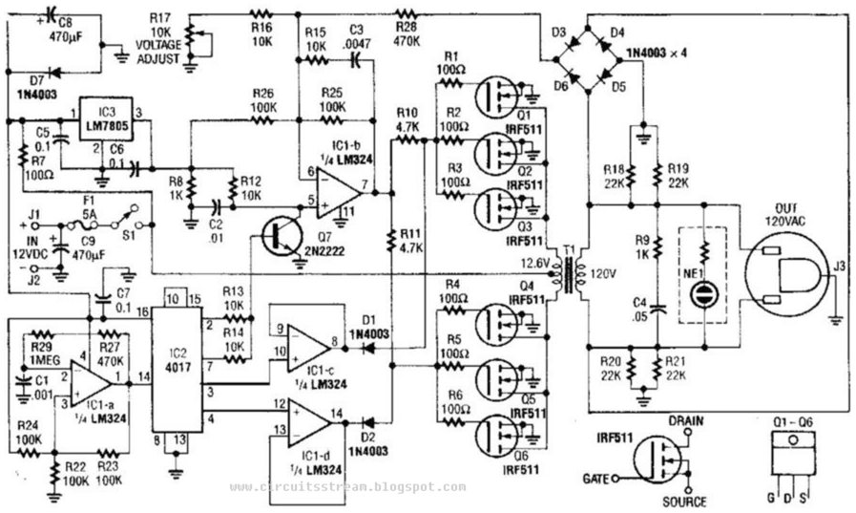
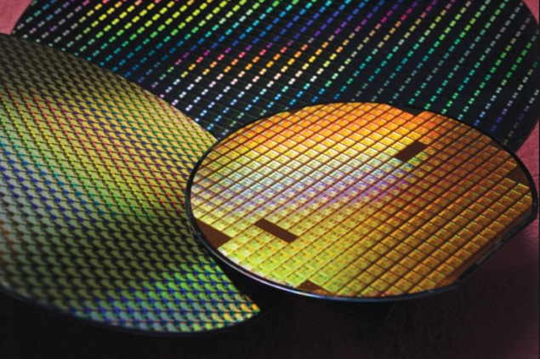
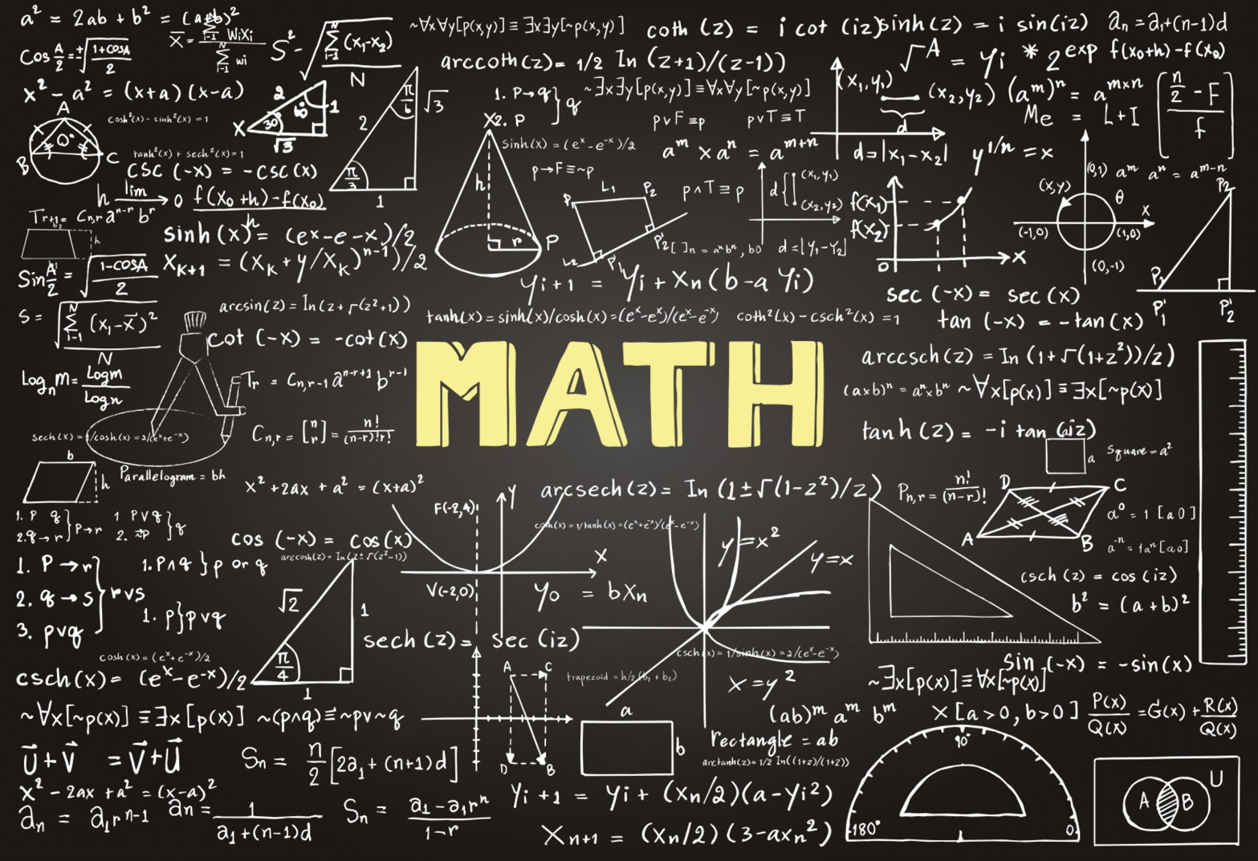
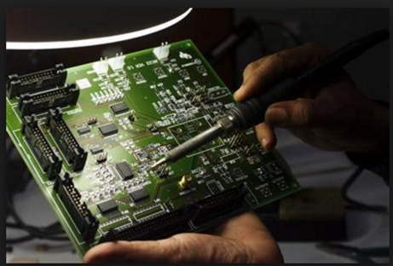
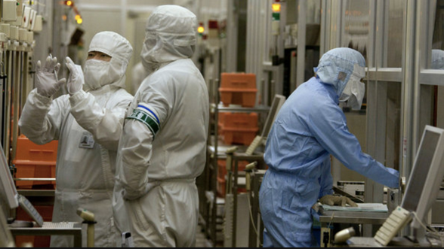

Slide 7
This course is about
Improving your ability to apply mathematics to engineering problems
Showing how a mathematical solution is implemented in modern engineering practice using software
Encouraging you to conceptually separate a solution to a problem from the implementation of that solution
Injecting discipline in writing and testing computational software
A “finishing course” for you to actually implement DSP solutions for things like audio processing, video processing, deep learning and so on

Slide 8
Computational Engineering and Numerical Methods enable
Simulating the real world so we can design and test a “part” before we build a real prototype
Visual FX in the movies
Weather prediction
Predictive Models for Bioengineering
Design Effective and Sustainable Solutions
Speech recognition
Video compression for : Netflix and YouTube and Television
Driverless cars
Uber and Google Maps
Automatic trading on the stock market
etc
Three big ideas
Engineering Approximation, Digital Signal Processing
and Computational Thinking

Slide 9
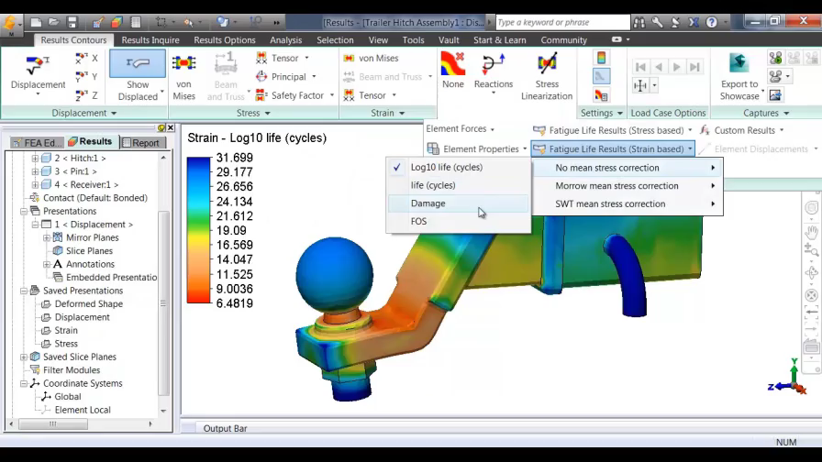
Autocad Mechanical : A vital design tool

Slide 10
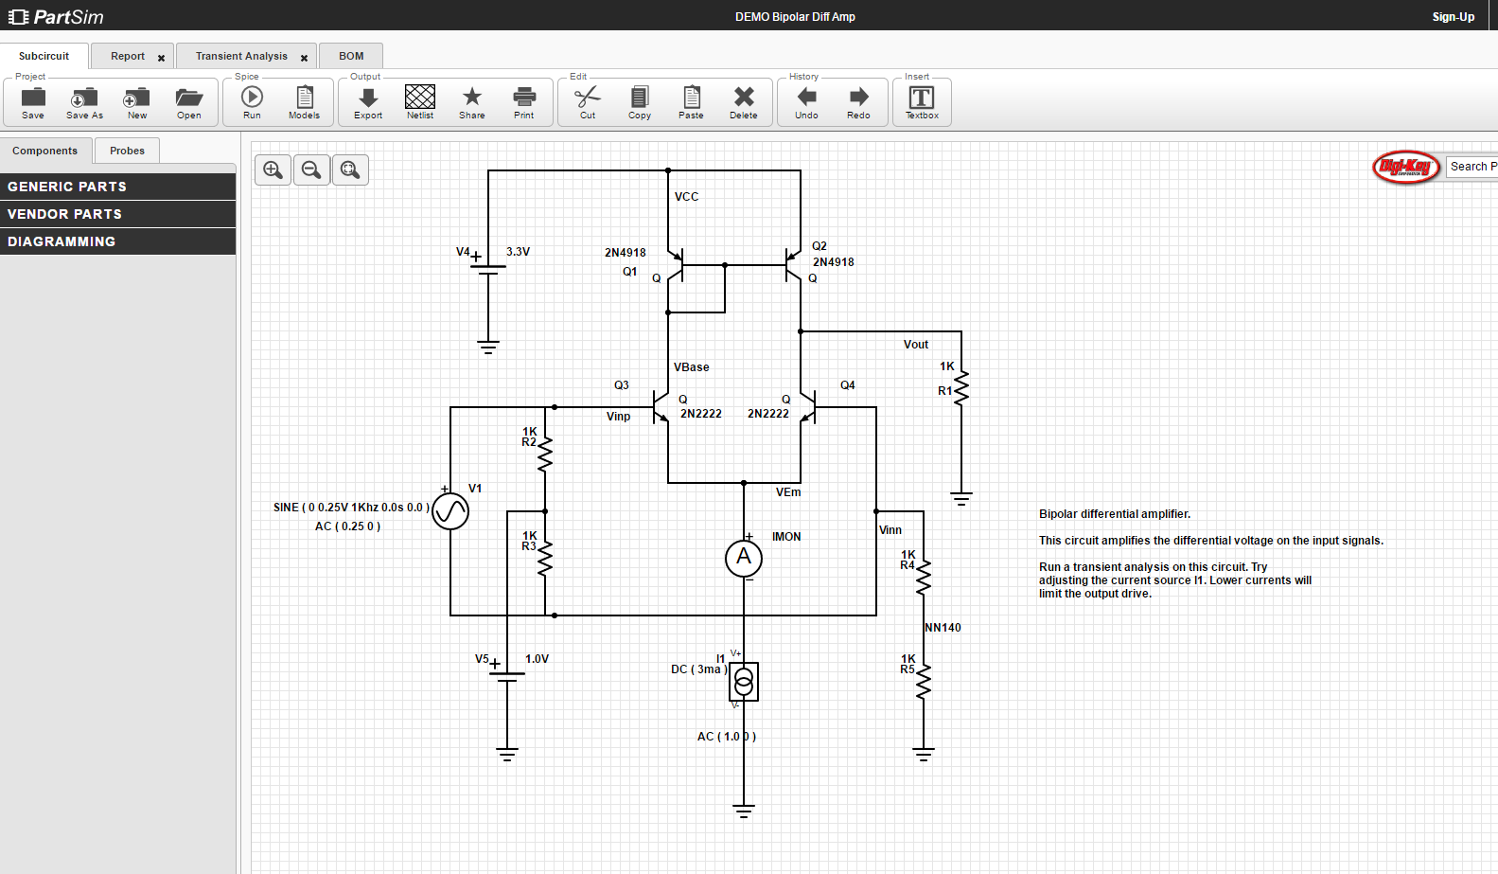
PSPICE : Key tool in Circuit Design

Slide 11
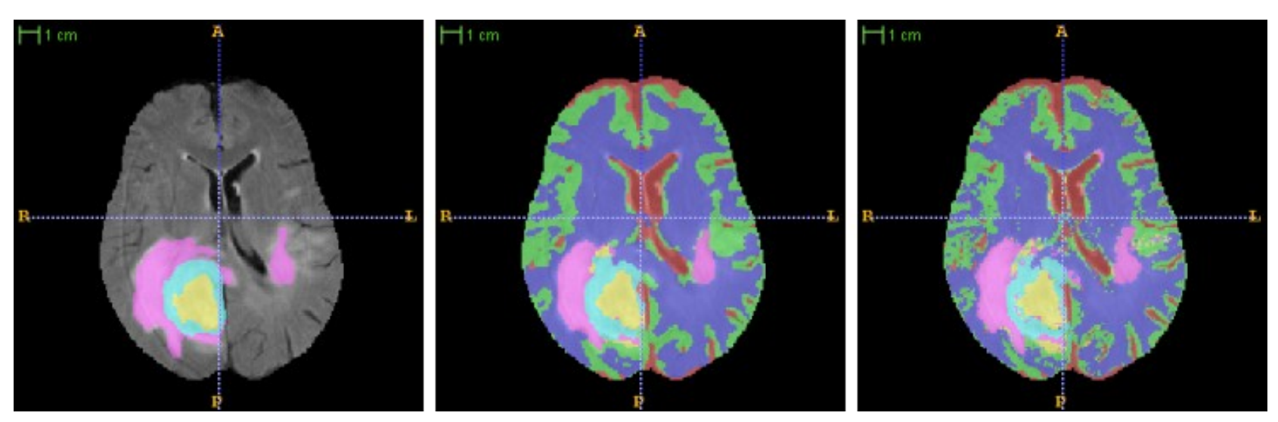
Image Processing : Automated Diagnosis

Slide 12
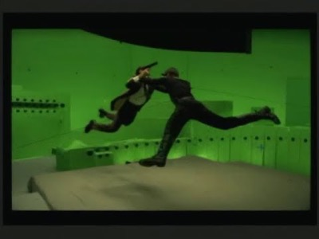

Bullet Time
Notes:
Bullet time is a visual effect or visual impression of detaching the time and space of a camera (or viewer) from that of its visible subject. It is a depth enhanced simulation of variable-speed action and performance found in films, broadcast advertisements, and realtime graphics within video games and other special media. It is characterized by its extreme transformation of both time (slow enough to show normally imperceptible and unfilmable events, such as flying bullets), and of space (by way of the ability of the camera angle—the audience's point-of-view—to move around the scene at a normal speed while events are slowed).

Slide 13
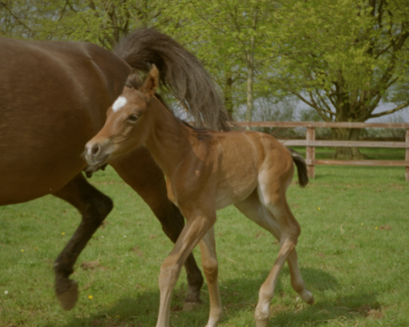
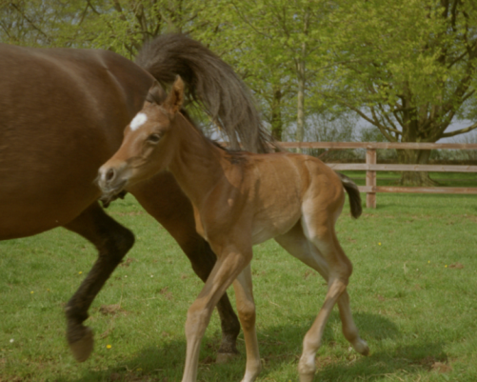
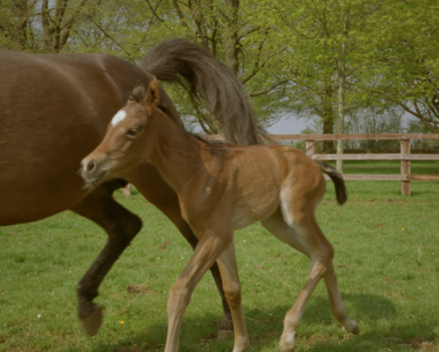
Object

Slide 14
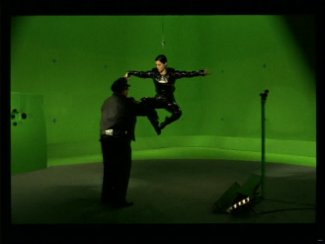
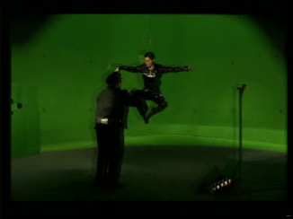
e
Object
Cameras too big to be close enough!
d
a
c
b
How can we “construct” the pictures in between the camera? A? C? E?
A?
b
C?
d
E?

Slide 15
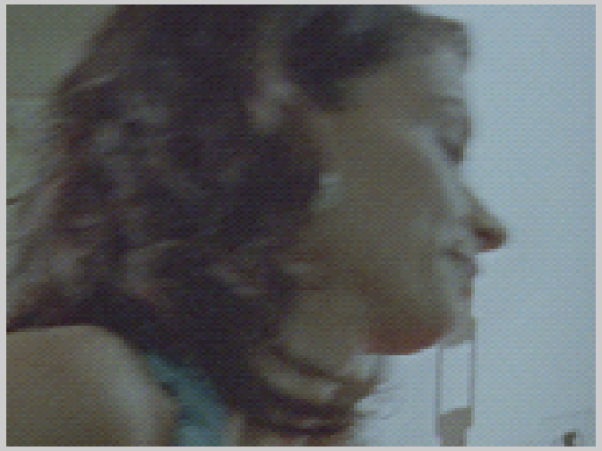
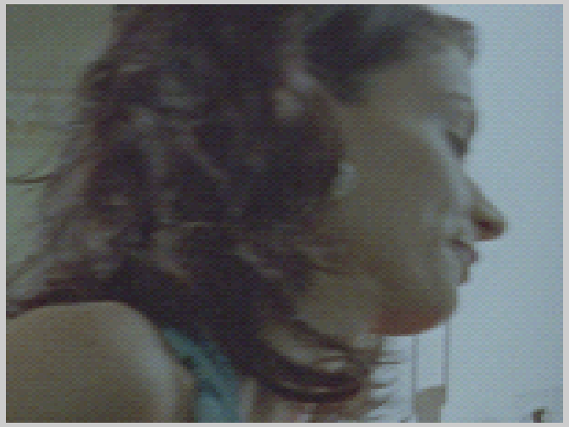
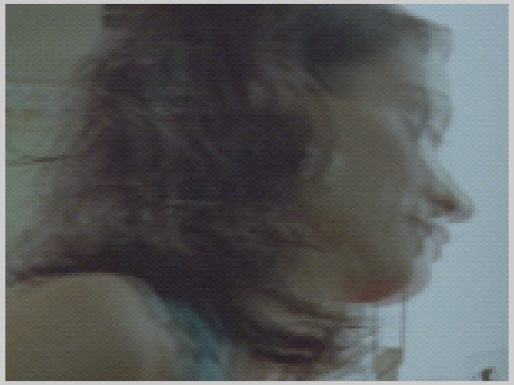
Thinking about “in-between” pictures
Current
Next
Blurring due to motion
Would this solution work??
How would the visual quality be?
(Current+Next)/2

Slide 16
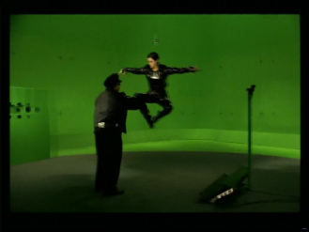
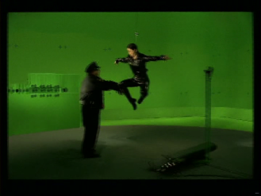
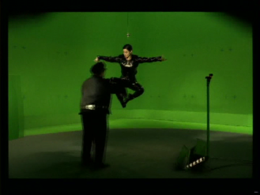
e
Need more information about the motion!
Object
a
c
d
b
A?
b
C?
d
E?

Slide 17
Some observations that help
The cameras always cause smooth movement
When things move
They don’t change colour much

Slide 18
Bullet Time : Mathematical modelling
67
70
55
0
23
67
-1
60
55
1
42
23
35
60
30
42

Slide 19
Bullet Time : How to solve for
-1
1

Slide 20
Bullet Time : The Equation is actually 2D!
Oh bugger.
There is no analytic solution. We don’t have an explicit form for I(x,y)
And the solution is HUGE.
There is a dx and dy for EVERY PIXEL in EVERY frame!
4 Million Variables!

Slide 21
Brute force numerical solution : examine subset of possible pixel pairs and pick the pair which gives least “squared error”
+1
-1
Left Camera
Right Camera

Slide 22
+2
-2
Left Camera
Right Camera

Slide 23
+2
-2
Left Camera
Right Camera

Slide 24
+1
Yea!
-1
Left Camera
Right Camera

Slide 25
Try the same displacement for neighbouring pixels
+1
-1

Slide 26
Try the same displacement for neighbouring pixels
+1
-1

Slide 27
What about implementation?
function [new_frame] = inbetween(left, right, w)
%Inputs are left and right vectors of pixels, and w the search space
rows = length(left);
new_frame = zeros(size(left));
for k = w + 1 : rows - w,
error = zeros(w*2+1,1);
%At this pixel location "k", calculate the error
%associated with every possible offset dy
for dy = -w : w,
error(dy + w + 1) = (left(k - dy) - right(k + dy))^2;
end;
%Select the dy that minimised the error
[y, index] = min(error);
estimated_dy = index - w - 1;
%Use it to calculate an interpolated value
new_frame(k) = (left(k - estimated_dy) + right(k + estimated_dy))/2;
end;

Slide 28
Actually, this simple “algorithm” has issues...
Search space is “integer” but the motion is “fractional”
We need to work in colour i.e. 3 pixels at each location not one
There is noise in real signals .. So the pixel differences will be “noisy”
That leads to random motion estimates
Which leads to “weirdly distorted” in-betweens.
No guarantee that the motion estimates are “smooth enough”
In real life sometimes you can’t find a match because objects move behind or in front of each other. So the “mathematical model” is not right everywhere.
That leads to objects sticking to background
It is too dirt slow!

Slide 29
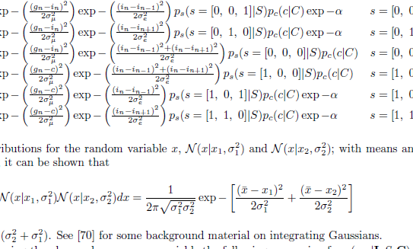
So we need better modelling etc etc
EEP5C22 ++!

Slide 30
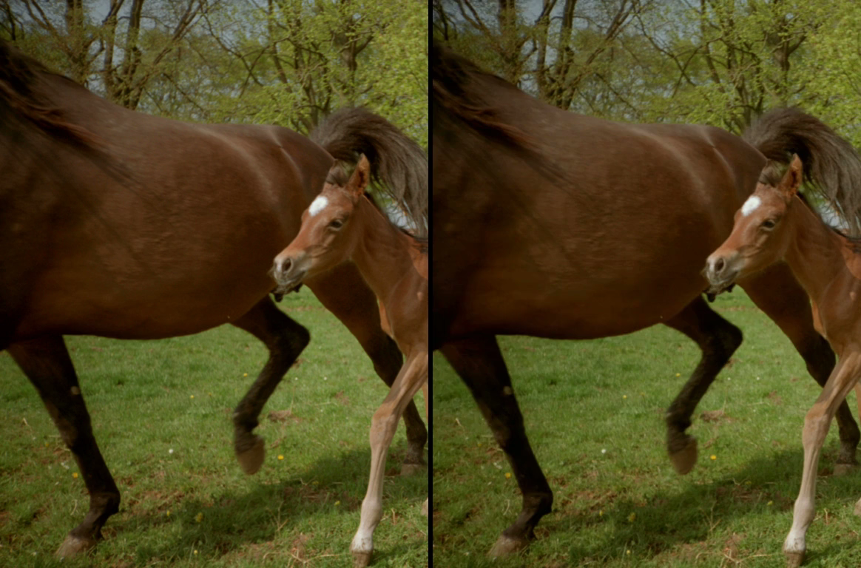

Slide 31
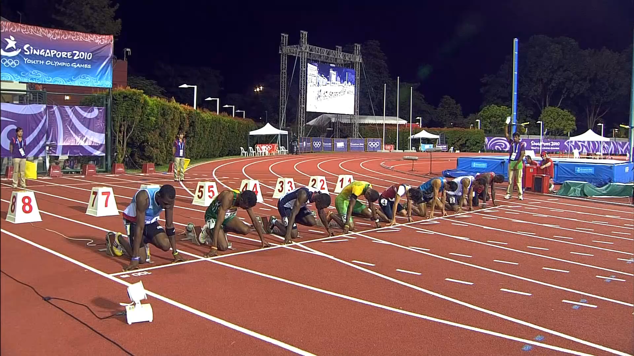
Slow Motion Too?

Slide 32

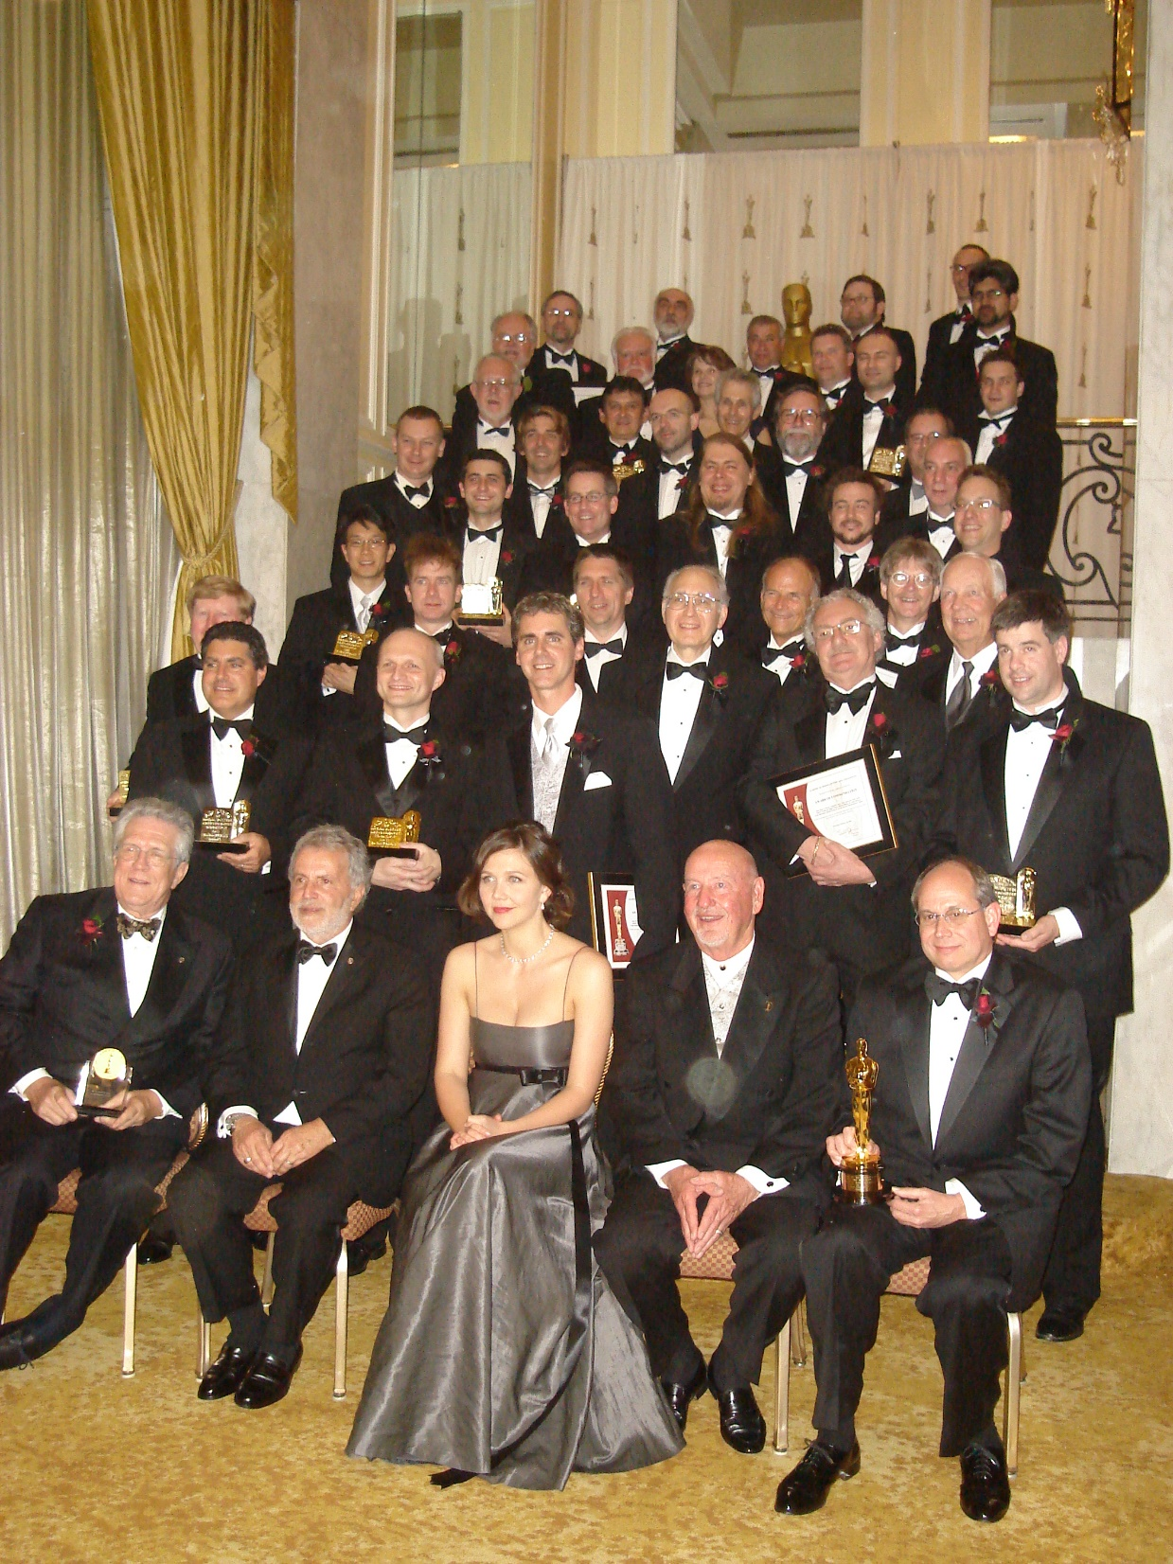

Slide 33
Course Content
Motivation, Matlab Refresher
Time Series Analysis with AR Models
Least Squares, Linear Algebra, Matrix Methods
Unconstrained Nonlinear optimization
Numerical Bayesian Techniques
…
Writing Readable Computational Code
Thinking Computationally
Thinking about memory/speed
Matlab first then Python
Writing Tests for Computational Code
Using Git
Writing short summaries of computational algorithms
Measuring performance
Working in teams!

Slide 34
Learning Outcomes On successful completion of this module students will be able to :
LO1. Express mathematical engineering solutions in terms of an algorithmic implementation
LO2. Design efficient computational frameworks in Matlab and Python adapted to the domain of the data used e.g. video or audio or biomedical.
LO3. Deploy standard libraries in Matlab and Python to solve problems in system modeling, machine learning and signal processing.
LO4. Design and implement tests for computational algorithms.
LO5. Use Git for version control and software management.
LO6. Quantify and manipulate resource trade-offs concerning speed, memory, energy consumption and power dissipation in the design of computational implementations.
LO7. Adapt a computational implementation for large scale deployment and deploy high level scripting for large scale experimentation.
LO8. Assess the suitability of algorithms for deployment in cloud-based systems or “on premise”.
LO9. Communicate the key aspects of a computational implementation succinctly and correctly.

Slide 35
Course Texts and Online Resources
Texts
Online Resources
Data Driven Science and Engineering , Brunton and Kutz, Cambridge Uni Press, Feb 2019
Numerical Recipes in C: The Art of Scientific Computing by Press, Flannery, Teukolsky and Vetterling
Introduction to Linear Algebra by Strang
Advanced Engineering Mathematics by Kreyzig
SVD Overview, Steven Brunton, University of Washington: https://www.youtube.com/watch?v=gXbThCXjZFM&list=PLMrJAkhIeNNRpsRhXTMt8uJdIGz9-X_1-
Matlab Online and Mathworks:
https://matlabacademy.mathworks.com/details/matlab-onramp/gettingstarted
MIT Open Courseware (https://ocw.mit.edu) : Strang’s lectures e.g. U0xlKuFqCuI
Andrew Ng’s lectures on Machine Learning (Coursera)

Slide 36
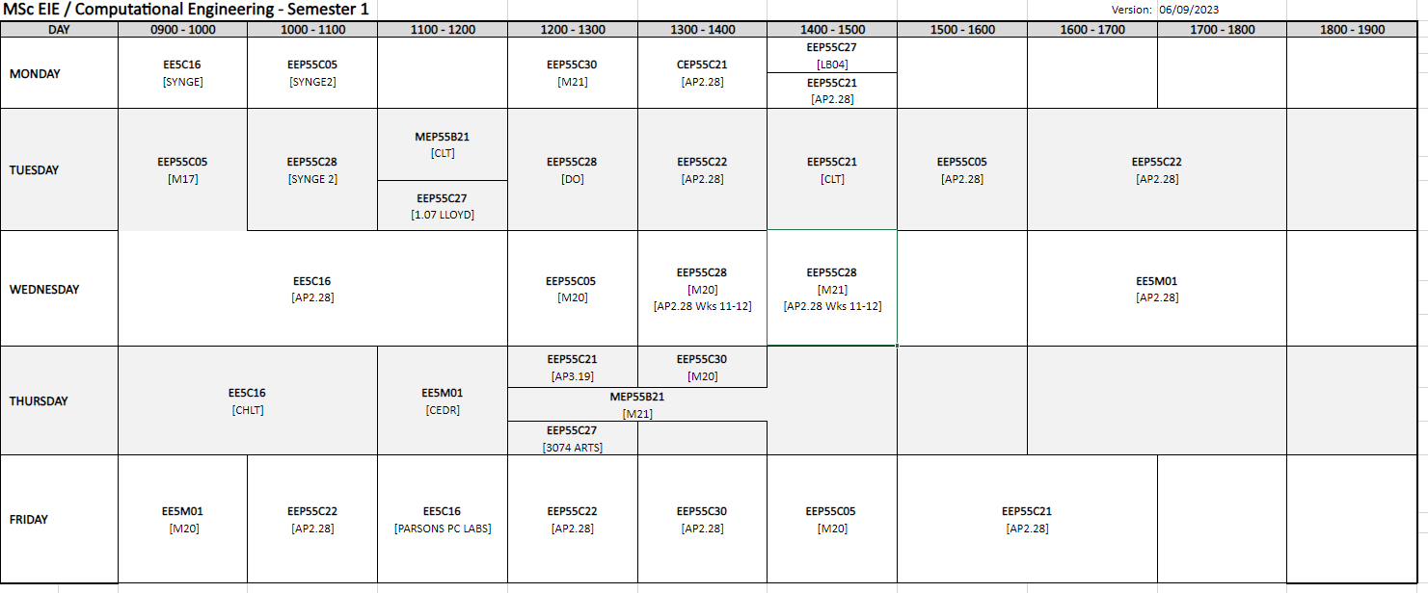

Interchangeable Lectures and practical sessions. We are going to solve real computational problems using code.

Slide 37
Marking and Course Delivery
Delivery
ppt presentations and notes
Blackboard (check that you have access!)
Video Conferencing, if needed
Assessment (roughly)
Semester 1
Matlab Grader Exercises 15%
Missing Data Exercise - Python 20%
Final Lab exercise -15%
Semester 2 Exercise 50%

Slide 38
Lessons
Separate in your head the design of a solution from the implementation
Programming alone will not provide answers. Just because I can use saws and hammers doesn’t mean I can design and install a kitchen.
Numerical methods underlie ALL modern simulation and information extraction systems and products.
Next stop : Refresher with Matlab and Numerical Solution to Differential Equations

